Slide 1
Chapter 7
PHASE EQUILIBRIUM IN A ONE-COMPONENT SYSTEM
7.1 INTRODUCTION
The intensive thermodynamic properties of a system are temperature, pressure, and the chemical potentials of the various species occurring in the system, and these properties are measures of potentials of one kind or another.
The temperature of a system is a measure of the potential or intensity of heat in the system, and temperature is thus a measure of the tendency for heat to leave the system. For example, if two parts of a system are at different temperatures, a heatpotential gradient exists which produces a driving force for the transport of heat down the gradient from the part at the higher temperature to the part at the lower temperature. Spontaneous heat flow occurs until the thermal gradient has been eliminated, in which state the heat is distributed at uniform intensity throughout the system. Thermal equilibrium is thus established when the heat potential, and hence the temperature, are uniform throughout the system.
The pressure of a system is a measure of its potential for undergoing massive movement by expansion or contraction. If, in a system of fixed volume, the pressure exerted by one phase is greater than that exerted by another phase, then the tendency of the first phase to expand exceeds that of the second phase. The pressure gradient is the driving force for expansion of the first phase, which decreases its pressure and hence its tendency for further expansion, and contraction of the second phase, which increases its pressure and hence its tendency to resist further contraction. Mechanical equilibrium is established when the massive movement of the two phases has occurred to the extent that the pressure gradient has been eliminated, in which state the pressure is uniform throughout the system.
The chemical potential of the species i in a phase is a measure of the tendency of the species i to leave the phase. It is thus a measure of the “chemical pressure” exerted by i in the phase. If the chemical potential of i has different values in different phases of the system, which are at the same temperature and pressure, then, as the escaping tendencies differ, the species i will tend to move from the phases in which it occurs at the higher chemical potential to the phases in which it occurs at the lower chemical potential. A gradient in chemical potential is the driving force for chemical diffusion, and equilibrium is attained when the species i is distributed throughout the various phases in the system such that its chemical potential has the same value in all phases.
In a closed system of fixed composition, e.g., a one-component system, equilibrium, at the temperature T and the pressure, P, occurs when the system exists in that state which has the minimum value of G′. The equilibrium state can thus be determined by means of an examination of dependence of G on pressure and temperature. In the following discussion the system H₂O will be used as an example.

Slide 2

174 Introduction to the Thermodynamics of Materials
7.2 THE VARIATION OF GIBBS FREE ENERGY WITH TEMPERATURE AT CONSTANT PRESSURE
At a total pressure of 1 atm, ice and water are in equilibrium with one another at 0°C, and hence, for these values of temperature and pressure, the Gibbs free energy, G′, of the system has its minimum value. Any transfer of heat to the system causes some of the ice to melt at 0°C and 1 atm pressure, and, provided that some ice remains, the equilibrium between the ice and the water is not disturbed and the value of G′ for the system is unchanged. If, by the addition of heat, 1 mole of ice is melted, then for the change of state
Thus, at the state of equilibrium between ice and water,
(7.1)
where is the molar Gibbs free energy of H₂O in the solid (ice) phase, and
is the molar Gibbs free energy of H₂O in the liquid (water) phase. For the system of
ice+water containing n moles of H₂O, which are in the ice phase and of which are in the water phase, the Gibbs free energy of the system, G′, is
(7.2)
and from Eq. (7.1) it is seen that, at 0°C and 1 atm pressure, the value of G′ is independent of the proportions of the ice phase and the water phase present.
The equality of the molar Gibbs free energies of H₂O in the solid and liquid phase at
0°C and 1 atm corresponds with the fact that, for equilibrium to occur, the escaping tendency of H₂O from the liquid phase must equal the escaping tendency of H₂O from
the solid phase. Hence it is to be expected that a relationship exists between the molar Gibbs free energy and the chemical potential of a component in a phase. Integration of Eq. (5.25) at constant T and P gives

Slide 3

Phase Equilibrium in a One-Component System 175
which, for the ice+water system, is written as
(7.3)
Comparison of Eqs. (7.2) and (7.3) shows that or, in general, µ_{i}=G_{i}; i.e.,
the chemical potential of a species in a particular state equals the molar Gibbs free energy of the species in the particular state.
This result could also have been obtained from a consideration of Eq. (5.16)
In a one-component system, the chemical potential of the component equals the increase in the value of G′ which occurs when 1 mole of the component is added to the system at constant T and P. That is, if the component is the species i,
and as the increase in the value of G′ for the one-component system is simply the molar Gibbs free energy of i, then
If the ice+water system is at 1 atm pressure and some temperature greater than 0°C, then the system is not stable and the ice spontaneously melts. This process decreases the Gibbs free energy of the system, and equilibrium is attained when all of the ice has melted. That is, for the change of state H₂O_{(s)} → H₂O_{(l)} at T>273 K, and P=1 atm,
i.e.
The escaping tendency of H₂O from the solid phase is greater than the escaping tendency of H₂O from the liquid phase. Conversely, if, at P=1 atm, the temperature is less than 0°C, then

Slide 4
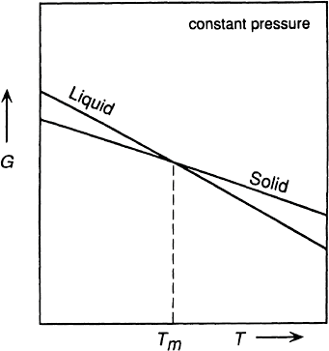

176 Introduction to the Thermodynamics of Materials
The variations of and
with temperature at constant pressure are shown
in Fig. 7.1 and the variation of OG_{ssl} with temperature at constant pressure is shown
in Fig. 7.2.
Figs. 7.1 and 7.2 show that, at 1 atm pressure and temperatures greater than 0°C, the minimum Gibbs free energy occurs when all of the H₂O is in the liquid phase,
Figure 7.1 Schematic representation of the variations of the molar Gibbs free energies of solid and liquid water with temperature at constant pressure.
and at 1 atm pressure and temperatures lower than 0°C, the minimum Gibbs free energy occurs when all of the H₂O is in the solid phase. The slopes of the lines in Fig. 7.1 are obtained from Eq. (5.25) as

Slide 5


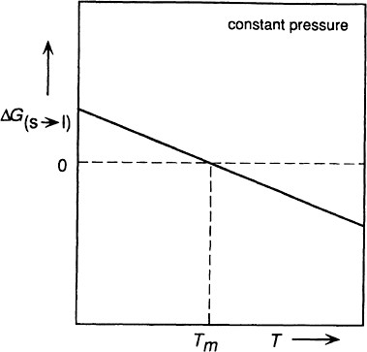
Phase Equilibrium in a One-Component System 177
and the curvatures of the lines are obtained from Eq. (6.12) as
Similarly, the slope of the line in Fig. 7.2 is given as
where OS is the change in the molar entropy which occurs as a result of the change of state. The slope of the line in Fig. 7.2 is negative, which shows that, at all temperatures,
Figure 7.2 Schematic representation of the variation of the molar Gibbs free energy of melting of water with temperature at constant pressure.
as is to be expected in view of the fact that, at any temperature, the liquid phase is more disordered than is the solid phase.

Slide 6
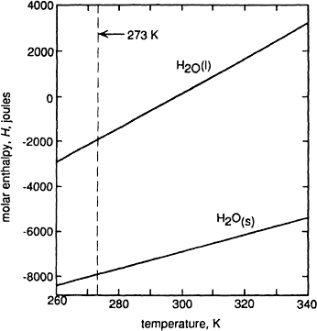
178 Introduction to the Thermodynamics of Materials
The state in which the solid and liquid phases of a one-component system are in equilibrium with one another can be determined from consideration of the molar enthalpy H and the molar entropy S of the system. From Eq. (5.2),
This can be written for both the solid and the liquid phases, and
For the change of state solid → liquid, subtraction gives
where OH_{(ssl)} and OS_{(ssl)} are, respectively, the changes in the molar enthalpy and molar entropy which occur as a result of melting at the temperature T. From Eq. (7.1)
Figure 7.3 The variations, with temperature, of the molar enthalpies of solid and liquid water at 1 atm pressure. The molar enthalpy of liquid water at 298 K is arbitrarily assigned the value of zero.

Slide 7
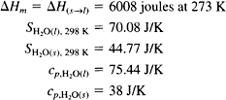


Phase Equilibrium in a One-Component System 179
equilibrium between the solid and the liquid phases occurs at that state at which
OG_{(ssl)}=0. This occurs at that temperature T_{m} at which
(7.4)
For H₂O
Fig. 7.3 shows the variations of H_{(s)} and H_{(l)} at 1 atm pressure, in which, for convenience,
H_{(l),298 K} is arbitrarily assigned the value of zero, in which case
and
The molar enthalpy of melting at the temperature T, OH_{(ssl),T} is the vertical separation between the two lines in Fig. 7.3.

Slide 8


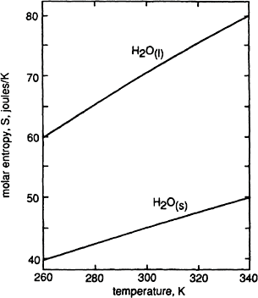
180 Introduction to the Thermodynamics of Materials
Fig. 7.4 shows the variations of S_{(s)} and S_{(l)} with temperature at 1 atm pressure, where
and
Figure 7.4 The variations, with temperature, of the molar entropies of solid and liquid water at 1 atm pressure.

Slide 9
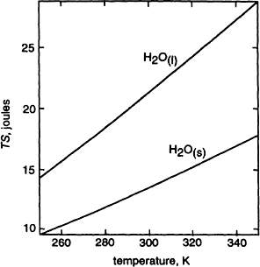
Phase Equilibrium in a One-Component System 181
Figure 7.5 The variation h, with temperature, of TS for solid and liquid water at 1 atm pressure.
The molar entropy of melting at the temperature T, O_{S(ssl)} is the vertical separation between the two lines in Fig. 7.4. Fig. 7.5 shows the corresponding variations of TS_{(S)}
and TS_{(l)} with temperature. Equilibrium between the solid and liquid phases occurs at that temperature at which the vertical separation between the two lines in Fig. 7.3 equals the vertical separation between the two lines in Fig. 7.5. This unique temperature is T_{m}, and,
at this temperature,
In Fig. 7.6, OH_{(ssl)}, TOS_{(ssl)}, and OG_{(ssl)} are plotted as functions of temperature using the data in Figs. 7.3 and 7.5. This figure shows that OG_{(s s l)}=0 at T=T_{m}= 273 K, which is
thus the temperature at which solid and liquid water are in equilibrium with one another at 1 atm pressure.
Equilibrium between two phases thus occurs as the result of a compromise between enthalpy considerations and entropy considerations. Equilibrium requires that G′ for the system have its minimum value at the fixed values of P and T, and Eq. (5.2) shows that minimization of G′ requires that H be small and S be large. Fig. 7.3 shows that, at all temperatures, H_{(l)}>H_{(s)}, and thus, from consideration of the contribution of enthalpy to
the Gibbs free energy, and in the absence of any other consideration, it would seem that the solid would always be stable with respect to the liquid. However Fig 7.4 shows that,

Slide 10
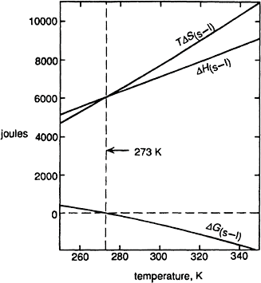
182 Introduction to the Thermodynamics of Materials
at all temperatures, S_{(l)}>S_{(s)}. Thus from consideration of the contribution of entropy to
the Gibbs free energy, in the absence of any other consideration, it would seem that the liquid phase is always stable with respect to the solid phase. However, as the contribution of the entropy, TS, to G is
Figure 7.6 The variations, with temperature, of the molar Gibbs free energy of melting, the molar enthalpy of melting, and T×the molar entropy of melting of water at 1 atm pressure.
dependent on temperature, a unique temperature T_{m} occurs above which the contribution of the entropy outweighs the contribution of the enthalpy and below which the reverse is the case. The temperature T_{m} is that at which H_{(l)}–T_{m}S_{(l)} equals H_{(s)}– T_{m}S_{(s)} and hence is
the temperature at which the molar Gibbs free energy of the solid has the same value as the molar Gibbs free energy of the liquid. This discussion is analogous to that presented in Sec. 5.3 where, at constant T and V, the equilibrium between a solid and its vapor was examined in terms of minimization of the Helmholtz free energy, A, of the system.

Slide 11


Phase Equilibrium in a One-Component System 183
7.3 THE VARIATION OF GIBBS FREE ENERGY WITH PRESSURE AT CONSTANT TEMPERATURE
Consider the application of Le Chatelier’s principle to ice and water, coexisting in equilibrium with one another at 0°C, when the pressure exerted on the system is increased to a value greater than 1 atm. Le Chatelier’s principle states that, when subjected to an external influence, the state of a system at equilibrium shifts in that direction which tends to nullify the effect of the external influence. Thus when the pressure exerted on a system is increased, the state of the system shifts in the direction which causes a decrease in its volume. As ice at 0°C has a larger molar volume than has water at 0°C, the melting of ice is the change in state caused by an increase in pressure. The influence of an increase in pressure, at constant temperature, on the molar Gibbs free energies of the phases is given by Eq. (5.25) as
i.e., the rate of increase of G with increase in pressure at constant temperature equals the molar volume of the phase at the temperature T and the pressure, P For the change of the state solid → liquid,
and as OV_{(ssl)} for H₂O at 0°C is negative, the ice melts when the pressure is increased to
a value greater than 1 atm. Thus, corresponding to Fig. 7.1, which showed the variation of G_{(s)} and G_{(l)} with T at constant P, Fig. 7.7 shows the variation of G_{(s)} and G_{(l)} with P at
constant T. Water is anomalous in that, usually, melting causes an increase in volume.

Slide 12
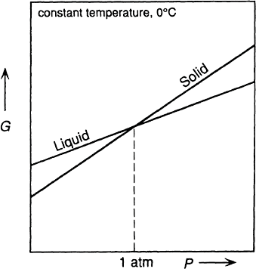
184 Introduction to the Thermodynamics of Materials
Figure 7.7 Schematic representation of the variations of the molar Gibbs free energies of solid and liquid water with pressure at constant temperature.
7.4 GIBBS FREE ENERGY AS A FUNCTION OF TEMPERATURE AND PRESSURE
Consideration of Figs. 7.1 and 7.7 shows that it is possible to maintain equilibrium between the solid and liquid phase by simultaneously varying the temperature and pressure in such a manner that OG_{(ssl)} remains zero. For equilibrium to be maintained
or, for any infinitesimal change in T and P,

Slide 13


Phase Equilibrium in a One-Component System 185
From Eq. (5.12)
and
Thus, for equilibrium to be maintained between the two phases,
or
At equilibrium OG=0, and hence OH=TOS, substitution of which into the above equation gives
Eq. (7.5), which is known as the Clapeyron equation, gives the required relationships between the variations of temperature and pressure which are required for the maintenance of equilibrium between the two phases.
The value of OV_{(ssl)} for H₂O is negative and OH_{(ssl)} for all materials is positive. Thus (dP/dT)_{eq} for H₂O is negative, i.e., an increase in pressure decreases the equilibrium melting temperature, and it is for this reason that iceskating is possible. The pressure of
the skate on the solid ice decreases its melting temperature, and, provided that the melting tem- perature is decreased to a value below the actual temperature of the ice, the ice melts to produce liquid water which acts as a lubricant for the skate on the ice. For most materials OV_{(ssl)} is pos-
itive, which means that an increase in pressure increases the equilibrium melting temperature. The thermodynamic states of the solid and liquid phase can be represented in a three- dimensional diagram with G, T, and P as coordinates; such a diagram, drawn schematically for H₂O, is shown in Fig. 7.8. In this figure each phase occurs on a

Slide 14
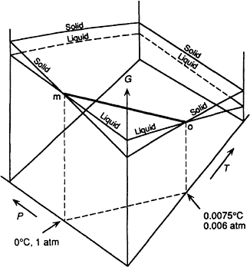
186 Introduction to the Thermodynamics of Materials
Figure 7.8 Schematic representation of the equilibrium surfaces of the solid and liquid phases of water in G-T-P space.
surface in G-T-P space, and the line along which the surfaces intersect represents the variation of P with T required for maintenance of the equilibrium between the two phases. At any state, which is determined by fixing the values of T and P, the equilibrium phase is that which has the lower value of G. Fig. 7.1, if drawn at P=0.006 atm, corresponds to the right front face of Fig. 7.8, and Fig. 7.7, if drawn for T=0°C, corresponds to the left front face of Fig. 7.8.
7.5 EQUILIBRIUM BETWEEN THE VAPOR PHASE AND A CONDENSED PHASE
If Eq. (7.5) is applied to an equilibrium between a vapor phase and a condensed phase then OV is the change in the molar volume accompanying evaporation or sublimation and OH is the corresponding change in the molar enthalpy, i.e., the molar latent heat of evaporation or sublimation. Thus

Slide 15





Phase Equilibrium in a One-Component System 187
and as V_{vapor} is very much larger than V_{condensed phase}, then, with the introduction of an insignificant error,
Thus, for condensed phase-vapor equilibria, Eq. (7.5) can be written as
in which V_{(v)} is the molar volume of the vapor. If it is further assumed that the vapor in equilibrium with the condensed phase behaves ideally, i.e., PV=RT, then
rearrangement of which gives
or
(7.6)
Eq. (7.6) is known as the Clausius-Clapeyron equation.
If OH is independent of temperature, i.e., if C_{p}(vapor)=C_{p}(condensed
integration of Eq. (7.6) gives
phase),
(7.7)
As equilibrium is maintained between the vapor phase and the condensed phase, the value of P at any T in Eq. (7.7) is the saturated vapor pressure exerted by the condensed phase at the temperature T. Eq. (7.7) thus shows that the saturated vapor pressure exerted by a condensed phase increases exponentially with increasing temperature, as was noted
in Sec. 5.3. If OC_{p} for the evaporation or sublimation is not zero, but is independent of temperature, then, from Eq. (6.9), OH_{T} Eq. (7.6) is

Slide 16



188 Introduction to the Thermodynamics of Materials
in which case integration of Eq. (7.6) gives
which is normally expressed in the form
(7.8)
In Eq. (7.8),
7.6 GRAPHICAL REPRESENTATION OF PHASE EQUILIBRIA IN A ONE-COMPONENT SYSTEM
In an equilibrium between a liquid and a vapor the normal boiling point of the liquid is defined as that temperature at which the saturated vapor pressure exerted by the liquid is 1 atm. Knowledge of the molar heat capacities of the liquid and vapor phases, the molar heat of evaporation at any one temperature, OH_{evap,T}, and the normal boiling temperature
allows the saturated vapor pressure-temperature to be determined for any material. For example, for H₂O
in the range of temperature 298–2500 K and
in the range of temperature 273–373 K. Thus, for the change of state

Slide 17

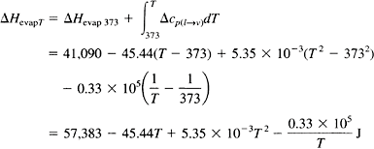


Phase Equilibrium in a One-Component System 189
At the normal boiling temperature of 373 K, OH_{evap}=41,090 J, and thus
Now
and so, with R=8.3144 J/K·mole,
At the boiling point of 373 K, p=1 atm, and thus the integration constant is evaluated as
51.10. In terms of logarithms to base 10, this gives
(7.9)
which is thus the variation of the saturated vapor pressure of water with temperature in the range of temperature 273–373 K. Curve-fitting of experimentally measured vapor pressure of liquid water to an expression of the form

Slide 18

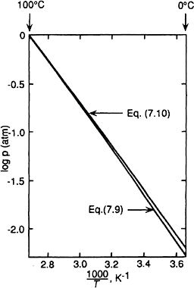
190 Introduction to the Thermodynamics of Materials
gives
(7.10)
Eqs. (7.9) and (7.10) are shown in Fig. 7.9 as plots of log p (atm) vs. inverse temperature. The agreement between the two lines increases with increasing temperature. In Fig. 7.9 the slope of the line at any temperature equals OH_{evap,T}/4.575. The saturated vapor
pressures of several of the more common elements are presented in Fig. 7.10, again as the variations of log p with inverse temperature.
Figure 7.9 The saturated vapor pressure of water as a function of temperature.
Fig. 7.11 is a one-component phase diagram which uses T and P as coordinates. Line AOA′ is a graphical representation of the integral of Eq. (7.5), which is the variation of pressure with temperature required for phase equilibrium between the solid and liquid phases. If OH_{m} is independent of temperature, integration of Eq. (7.5) gives an
expression of the form

Slide 19

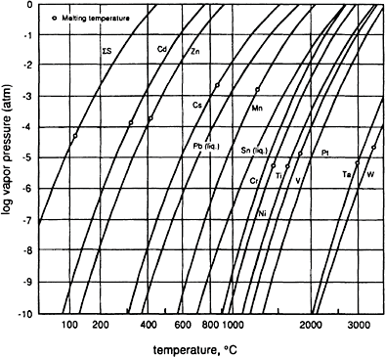
Phase Equilibrium in a One-Component System 191
(7.11)
By definition the normal melting temperature of the material is the melting temperature at a pressure of 1 atm, and in Fig. 7.11 the normal melting point is designated as the point
m. The line BOB′ is the line for equilibrium between the vapor and the liquid given by Eq. (7.7) or (7.9) in which OH_{T} is OH_{evap,T}. In the case of water the line BOB′ represents
the variation, with temperature, of the saturated vapor pressure of the liquid, or alternatively, the variation, with pressure, of the dew point of water vapor. The line BOB′ passes through the normal boiling point (represented by the point b in the figure) and intersects the line AOA′ at the triple point, O. The triple point is the state represented by the invariant values of P and T at which the solid, liquid, and vapor phases are in equilibrium with each other. Knowledge of the triple point, together with the value of OH_{sublim,T}, allows the variation of the saturated vapor pressure of the solid with
temperature to be determined. This equilibrium line is drawn as COC′ Fig. 7.11.
Figure 7.10 The vapor pressures of several elements as functions of temperature.

Slide 20
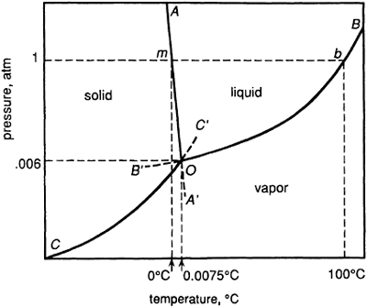
192 Introduction to the Thermodynamics of Materials
Figure 7.11 Schematic representation of part of the phase diagram for H₂O.
In the G-T-P surface for the states of existence of the vapor phase were included in Fig. 7.8, it would intersect with the solid-state surface along a line and would intersect with the liquid-state surface along a line. Projection of these lines, together with the line of intersection of the solid- and liquid-state surfaces, onto the two-dimensional P-T basal plane of Fig. 7.8 would produce Fig. 7.11. All three state surfaces in the redrawn Fig. 7.8 would intersect at a point, projection of which onto the P-T basal plane gives the invariant point O. The dashed lines OA′, OB′, and OC′ in Fig. 7.11 represent, respectively, metastable solid-liquid, metastable vapor-liquid, and metastable vapor-solid equilibria. The equilibria are metastable because, in the case of the line OB′, the intersection of the liquid- and vapor-state surfaces in the redrawn Fig. 7.8 lies at higher values of G than does the solid-state surface for the same values of P and T. Similarly, the solid-liquid equilibrium OA′ is metastable with respect to the vapor phase, and the solid-vapor equilibrium OC′ metastable with respect to the liquid phase.
Fig. 7.12a shows three isobaric sections of the redrawn Fig. 7.8 at P₁>P_{triple point}.
P =P , and P <P , and Fig. 7.12b shows three isothermal sections of the
2 triple point 3 triple point
redrawn Fig. 7.8 at T₁<T_{triple point}, T₂=T_{triple point}, T₃>T_{triple point}. In Fig. 7.12a, the slopes
of the lines in any isobaric section increase negatively in the order solid, liquid, vapor, in accordance with the fact that S_{(s)}<S_{(l)}<S_{(v)}. Similarly, in Fig. 7.12b the slopes of the lines
in any isothermal section increase in the order liquid, solid, vapor in accordance with the fact that, for H₂O, V_{(l)}<V_{(s)}<V_{(v)}.

Slide 21
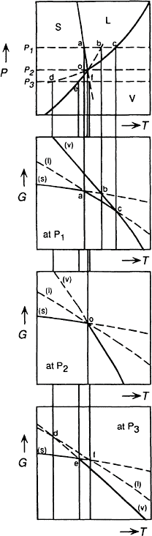
Phase Equilibrium in a One-Component System 193
Figure 7.12 (a) schematic representation of the constant-pressure variations of the molar Gibbs free energies of solid, liquid, and vapor H₂O at pressures above, at, and below the triple- point pressure.

Slide 22
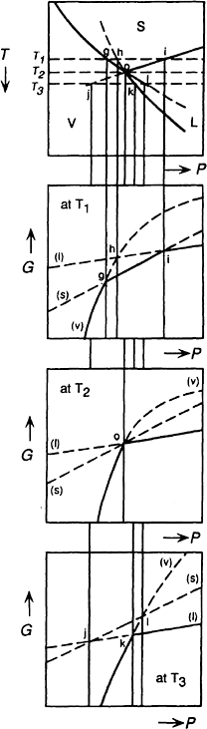
194 Introduction to the Thermodynamics of Materials
Figure 7.12 (b) Schematic representation of the constant-temperature variations of the molar Gibbs free energies of solid, liquid, and vapor H₂O at temperatures above, at, and below the triple- point temperature.

Slide 23

Phase Equilibrium in a One-Component System 195
The lines OA, OB, and OC divide Fig. 7.11 into three areas within each of which only one phase is stable. Within these areas the pressure exerted on the phase and the temperature of the phase can be independently varied without upsetting the one-phase equilibrium. The equilibrium thus has two degrees of freedom, where the number of degrees of freedom that an equilibrium has is the maximum number of variables which may be independently varied without upsetting the equilibrium. The single-phase areas meet at the lines OA, OB, and OC along which two phases coexist in equilibrium, and for continued maintenance of any of these equilibria only one variable (either P or T) can be independently varied. Two-phase equilibria in a one-component system thus have only one degree of freedom. The three two- phase equilibrium lines meet at the triple point, which is the invariant state at which solid, liquid, and vapor coexist in equilibrium. The three-phase equilibrium in a one-component system thus has no degrees of freedom, and three is therefore the maximum number of phases which can coexist at equilibrium in a one-component system. The number of degrees of freedom, F, that a system containing C components can have when P phases are in equilibrium is given by
This expression is called the Gibbs phase rule.
7.7 SOLID-SOLID EQUILIBRIA
Elements which can exist in more than one crystal form are said to exhibit allotropy, and chemical compounds which can exist in more than one solid form are said to exhibit polymorphism. The variation of pressure with temperature required to maintain equilibrium between two solids is given by Eq. (7.10) in which OH and OV are the changes in the molar enthalpy and the molar volume for the change of state solid I → solid II. The phase diagram for iron at relatively low pressures is shown in Fig. 7.13. Iron has body-centered crystal structures, the a and 6 phases, at, respectively, low and high temperatures, and a face-centered crystal structure, the μ phase at intermediate temperatures; Fig. 7.13 shows three triple points involving two condensed phases and the vapor phase. As atoms in the face-centered crystal structure fill space more efficiently than do atoms in the body-centered structure, the molar volume of μ-Fe is less than those of a-Fe and 6-Fe, and consequently, the line for equilibrium between a and μ has a negative slope, and the line for equilibrium between μ and 6 has a positive slope. With increasing pressure the slope of the μ-6 line becomes greater than that of the 6-liquid line, and the two lines meet at a triple point for the three-phase μ-6-liquid equilibrium at P=14,420 atm and T=1590°C. The vapor pressure of liquid iron, which is given by
reaches 1 atm at 3057°C, which is thus the normal boiling temperature of iron.
Fig. 7.14 shows a schematic representation of the variation, with temperature at constant pressure, of the molar Gibbs free energies of the bcc, fcc, liquid, and vapor

Slide 24
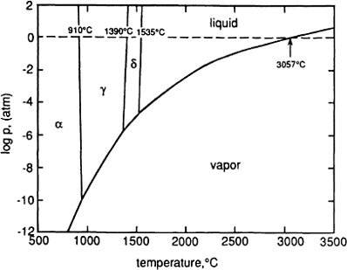
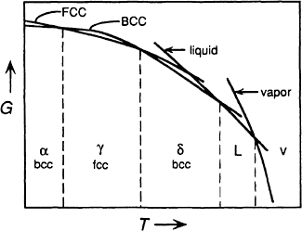
196 Introduction to the Thermodynamics of Materials
Figure 7.13 The phase diagram for iron.
Figure 7.14 Schematic representation of the variation of the molar Gibbs free energies of the bcc, fcc, liquid, and vapor phases of iron with temperature at constant pressure.

Slide 25
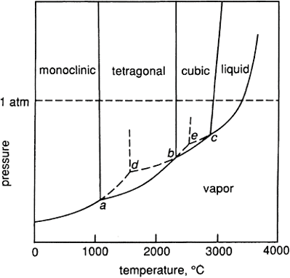
Phase Equilibrium in a One-Component System 197
phases of iron. The curvature of the bcc iron line is such that it intersects the fcc iron line twice, with the consequence that, at 1 atm pressure, bcc iron is stable relative to fcc iron at temperatures less than 910°C and at temperatures greater than 1390°C.
A schematic phase diagram for zirconia, ZrO₂, is shown in Fig. 7.15. Zirconia has monoclinic, tetragonal, and cubic polymorphs, and its existence in any of five phases (three polymorphs plus liquid and vapor) means that the phase diagram contains 5!/3!=20 triple points, five of which are shown in Fig. 7.15. The states a, b, and c are stable triple points for, respectively, the three-phase equilibria monoclinictetragonal-vapor, tetragonal- cubic-vapor, and cubic-liquid-vapor, and the states d and e are metastable triple points. The state d is that at which the extrapolated vapor pressure lines of the monoclinic and the cubic lines meet in the phase field of stable tetragonal ZrO₂. The state d is thus the
metastable triple point for the equilibrium between vapor, monoclinic, and cubic zirconia, which occurs at a higher value of molar Gibbs free energy than that of tetragonal zirconia at the same value of P and T. Similarly the state e, which is that at which the extrapolated vapor pressures of tetragonal and liquid zirconia intersect in the phase field of stable cubic zirconia, is the metastable triple point for equilibrium between liquid, vapor, and tetragonal zirconia.
Figure 7.15 A schematic phase diagram for zirconia, ZrO₂.

Slide 26
198 Introduction to the Thermodynamics of Materials
7.8 SUMMARY
Knowledge of the dependencies, on temperature and pressure, of the changes in molar enthalpy and molar entropy caused by phase changes in a system allows determination of the corresponding change in the molar Gibbs free energy of the system. As a closed one-component system has only two independent variables, the dependence of G can be examined most simply by choosing T and P as the independent variables (these are the natural independent variables when G is the dependent variable). The phases in which the material can exist can thus be represented in a three-dimensional diagram using G, P, and T as coordinates, and in such a diagram the various states in which the material can exist occur as surfaces. In any state, which is determined by the values of P and T, the stable phase is that which has the lowest Gibbs free energy. The surfaces in the diagram intersect with one another along lines, and these lines represent the variations of P with T required for equilibrium between the two phases. The intersection of the surfaces for the solid and liquid phases gives the variation of the equilibrium melting temperature with pressure, and the intersection of the surfaces for the liquid and vapor phases gives the variation of the boiling temperature with pressure. Respectively, the normal melting and boiling points of the material occur on these intersections at P=1 atm. Three surfaces intersect at a point in the diagram, and the values of P and T at which this intersection occurs are those of the invariant triple point at which an equilibrium occurs among three phases. In a one-component system no more than three phases can coexist in equilibrium with one another.
The three-dimensional G-T-P diagram illustrates the differences between stable, metastable, and unstable states and hence shows the difference between reversible and irreversible process paths. At any value of P and T the stable phase is that which has the lowest Gibbs free energy, and phases which have higher values of G at the same values of P and T are metastable with respect to the phase of lowest value of G. Phases with a value of G at any combination of P and T which do not lie on a surface in the diagram are unstable. A reversible process path involving a change in P and/or T lies on a phase surface, and the state of a phase is changed reversibly only when, during the change, the state of the system does not leave the surface of the phase. If the process path leaves the phase surface then the change of state, which necessarily passes through nonequilibrium states, is irreversible.
As the perspective representation, in two dimensions, of a three-dimensional diagram is difficult, it is normal practice to present the phase diagram for a one-component system as the basal plane of the G-T-P diagram, i.e., a P-T diagram, onto which are projected the lines along which two surfaces intersect (equilibrium between two phases) and the points at which three surfaces intersect (equilibrium among three phases). Such a diagram contains areas in which a single phase is stable, which are separated by lines along which two phases exist at equilibrium, and points at the intersection of three lines at which three phases coexist in equilibrium. The lines for equilibrium between a condensed phase and the vapor phase are called vapor pressure lines, and they are exponential in form. In view of the fact that saturated vapor pressures can vary over several orders of magnitude, phase diagrams can often be presented in more useful form as plots of log p vs. 1/T than as plots of P vs. T.

Slide 27



Phase Equilibrium in a One-Component System 199
The development of phase diagrams for one-component systems demonstrate the use of the Gibbs free energy as a criterion for equilibrium when T and P are chosen as the independent variables.
7.9 NUMERICAL EXAMPLES Example 1
The vapor pressure of solid NaF varies with temperature as
and the vapor pressure of liquid NaF varies with temperature as
Calculate:
The normal boiling temperature of NaF
The temperature and pressure at the triple point
The molar heat of evaporation of NaF at its normal boiling temperature
The molar heat of melting of NaF at the triple point
The difference between the constant-pressure molar heat capacities of liquid and solid NaF
The phase diagram is shown schematically in Fig. 7.16.
(a) The normal boiling temperature, T_{b}, is defined as that temperature at which the
saturated vapor pressure of the liquid is 1 atm. Thus from the equation for the vapor pressure of the liquid, T_{b}, is
which has the solution
(b) The saturated vapor pressures for the solid and liquid phases intersect at the triple point. Thus at the temperature, T_{tp}, of the triple point

Slide 28
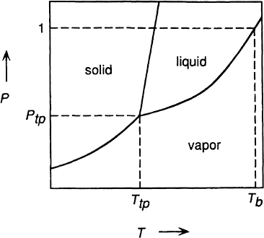
200 Introduction to the Thermodynamics of Materials
which has the solution
Figure 7.16 Schematic phase diagram for a one-component system.
The triple-point pressure is then calculated from the equation for the vapor pressure of the solid as
or from the equation for the vapor pressure for the liquid as

Slide 29




Phase Equilibrium in a One-Component System 201
(c) For vapor in equilibrium with the liquid,
Thus
and, at the normal boiling temperature of 2006 K
(d) For vapor in equilibrium with the solid
Thus
At any temperature
and thus

Slide 30



202 Introduction to the Thermodynamics of Materials
At the triple point
(e) OH_{(ssl)}=27,900+4.24T:
Example 2
Carbon has three allotropes: graphite, diamond, and a metallic form called solid III. Graphite is the stable form of 298 K and 1 atm pressure, and increasing the pressure on graphite at temperatures less than 1440 K causes the transformation of graphite to diamond and then the transformation of diamond to solid III. Calculate the pressure which, when applied to graphite at 298 K, causes the transformation of graphite to diamond, given
^{H}298 K, (graphite)^{–H}298 K, (diamond)^{=–1900 J}
^{S}298 K, (graphite)^{=5.74 J/K}
^{S}298 K, (graphite)^{=2.37 J/K}
The density of graphite at 298 K is 2.22 g/cm³ The density of diamond at 298 K is 3.515 g/cm³
For the transformation graphite → diamond at 298 K,
For the transformation of graphite to diamond at any temperature T,

Slide 31




Phase Equilibrium in a One-Component System 203
and
Thus
Equilibrium between graphite and diamond at 298 K requires that OG_{graphite→diamond} be zero. As
then
If the difference between the isothermal compressibilities of the two phases is negligibly small, i.e., if the influence of pressure on OV can be ignored, then, as
and thus
Transformation of graphite to diamond at 298 K requires the application of a pressure greater than 14,400 atm.
PROBLEMS
  Using the vapor pressure-temperature relationships for CaF_{2(a)}, CaF_{2(ß)}, and liquid CaF₂, calculate:
    The temperatures and pressures of the triple points for the equilibria CaF_{2(a)}
—CaF_{2(ß)}—CaF_{2(v)} and CaF_{2(ß)}—CaF_{2(l)}—CaF_{2(v)}

Slide 32



204 Introduction to the Thermodynamics of Materials
The normal boiling temperature of CaF₂
The molar latent heat of the transformation CaF_{2(a)} → CaF_{2(ß)}
The molar latent heat of melting of CaF_{2(ß)}
  Calculate the approximate pressure required to distill mercury at 100°C.
  One mole of SiCl₄ vapor is contained at 1 atm pressure and 350 K in a rigid container of fixed volume. The temperature of the container and its contents is cooled to 280 K. At what temperature does condensation of the SiCl₄ vapor begin, and what fraction of the vapor has condensed when the temperature is 280 K?
  The vapor pressures of zinc have been written as
(i)
and
(ii)
Which of the two equations is for solid zinc?
  At the normal boiling temperature of iron, T_{b}=3330 K, the rate of change of the vapor
pressure of liquid iron with temperature is 3.72×10^{–3} atm/K. Calculate the molar latent heat of boiling of iron at 3330 K.
  Below the triple point (–56.2°C) the vapor pressure of solid CO₂ is given as
The molar latent heat of melting of CO₂ is 8330 joules. Calculate the vapor pressure exerted by liquid CO₂ at 25 °C and explain why solid CO₂ is referred to as “dry ice.”
  The molar volumes of solid and liquid lead at the normal melting temperature of lead
are, respectively, 18.92 and 19.47 cm³. Calculate the pressure which must be applied to lead in order to increase its melting temperature by 20 centigrade degrees.
  Nitrogen has a triple point at P=4650 atm and T=44.5 K, at which state the allotropes a, ß, and μ coexist in equilibrium with one another. At the triple point
V –V =0.043 cm³/mole and V –V =0.165 cm3/mole. Also at the triple point
ß a a μ
S_{ß} S =4.59 J/K and S –S =1.25 J/K. The state of P=1 atm, T=36 K lies on the
– a a μ
boundary between the fields of stability of the a and ß phases, and at this state, for the
transformation of a → ß, OS=6.52 J/K and OV=0.22 cm³/mole. Sketch the phase diagram for nitrogen at low temperatures.
  Measurements of the saturated vapor pressure of liquid NdCl₅ give 0.3045 atm at 478
K and 0.9310 atm at 520 K. Calculate the normal boiling temperature of NdCl₅.

